Slide 1
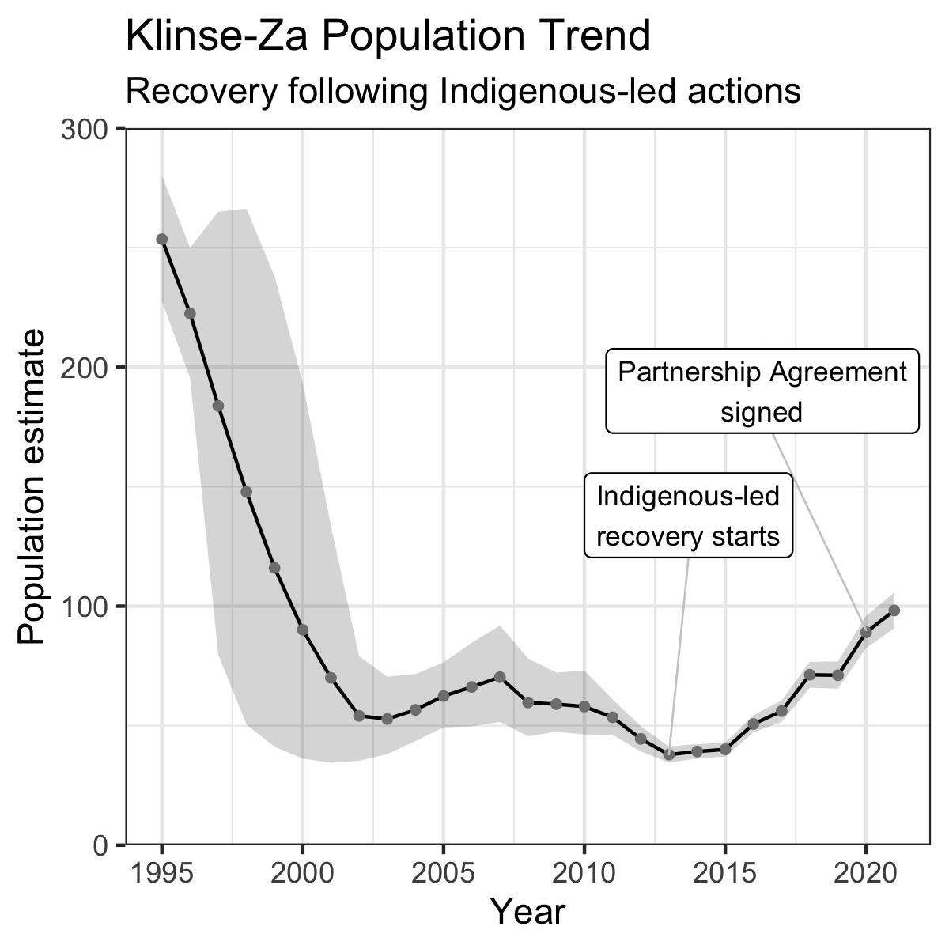



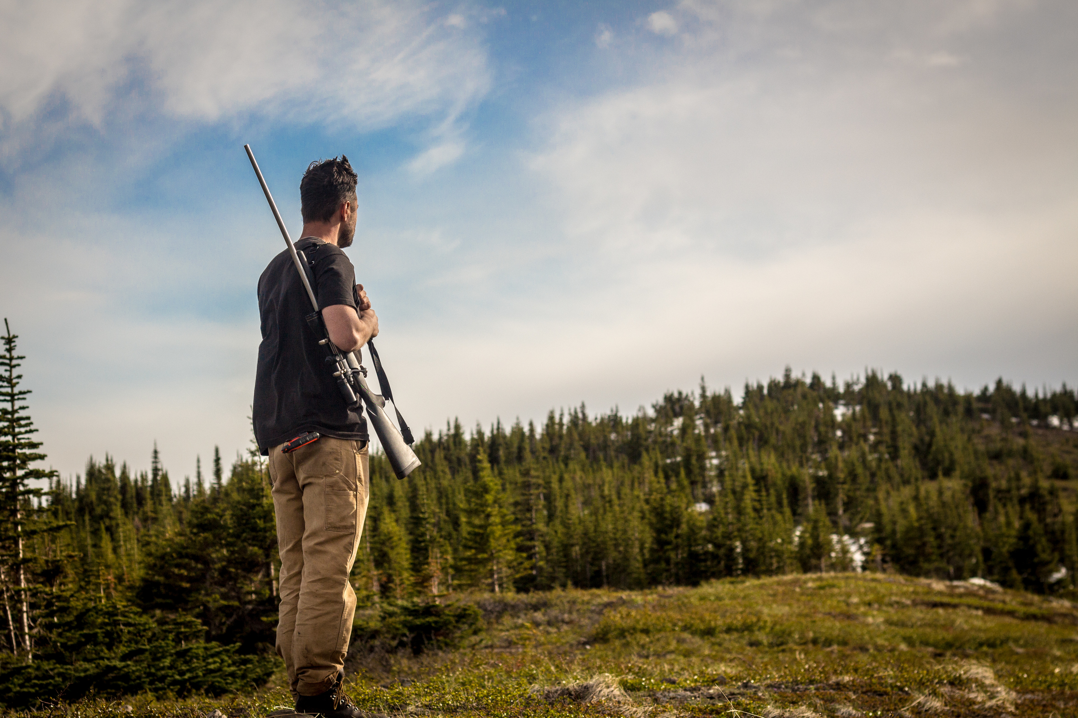
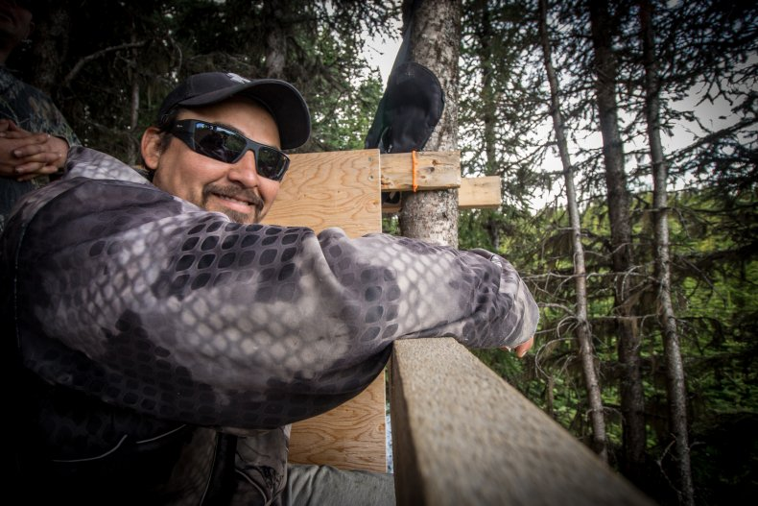
A
The Actions
B
Maternal Penning and Feeding
Indigenous Guardians on site full time
Predator Reduction-mainly wolves
By Indigenous Peoples, Province, and Trappers
Habitat Restoration and Security
Restored linear features and garnered Partnership Agreement
Why it Worked
Exercising Indigenous Rights
The Nations initiated immediate, emergency actions —unhindered by politics and permitting— to recover Klinse-Za caribou, without which extirpation was certain.
Increased Survival & Recruitment
The Actions reversed the decline and increased populations at ~13% per year
Collaborative, Equitable Approach
Involving Indigenous Peoples, Provincial and Federal Governments, local land stewards, and scientists
C

